Slide 1
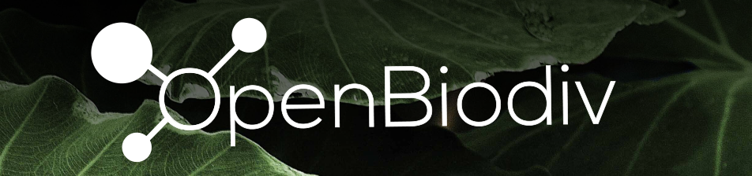
The Open Biodiverisity Knowledge Management System
Viktor Senderov – Ronquist Lab Seminar – 28.11.2017 Stockholm

Slide 2
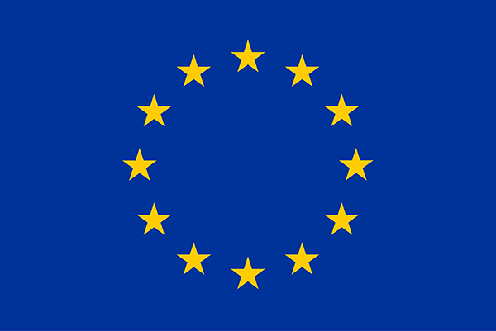
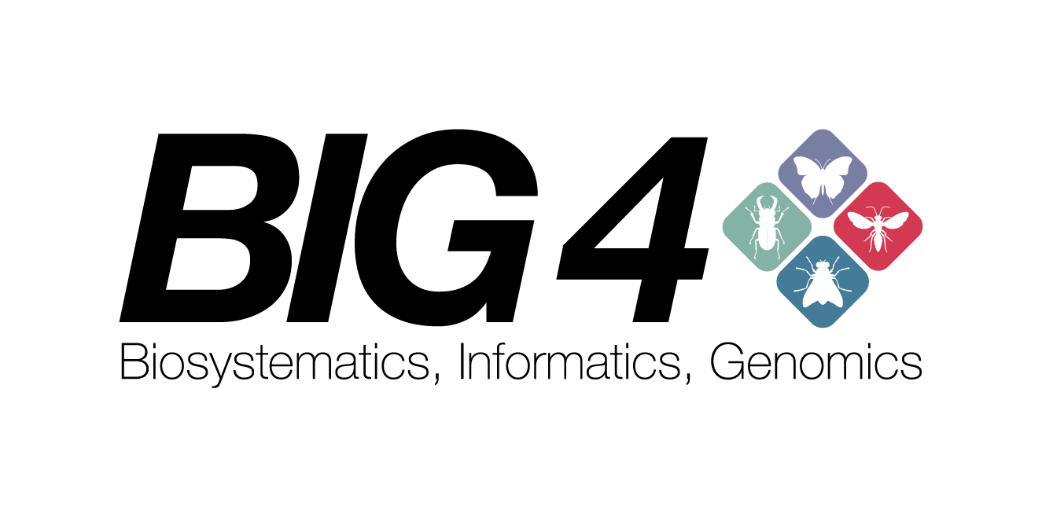


Project Overview
Financed through the European Union’s Horizon 2020 research and innovation program under the Marie Sklodovska-Curie grant agreement No. 642241. Responsibility for the information and views set out in this report lies entirely with the authors.

Slide 3
Outline
Knowledge Representation
Concept Taxonomy
OpenBiodiv
Ropenbio
Knowledge Extraction via Machine Learning

Slide 4
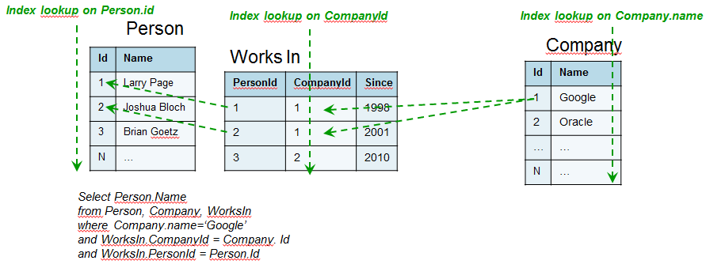
Relational Database Model https://blog.octo.com/en/graph-databases-an-overview/RequestInSQL.png
3 lookups needed

Slide 5
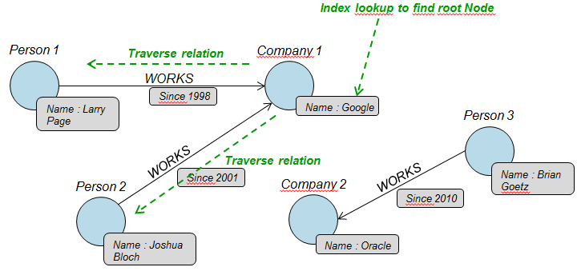
Graph Data Model https://blog.octo.com/wp-content/uploads/2012/07/RequestInGraph.png
1 lookup needed

Slide 6
RDBMS vs Graph Model
RDBMS
Graph Model
Support transactions (a unit of work/change in a database)
Better at counting and summing
Adding more datatypes might require redesign
Data relationships as first-class objects
Better at traversal
Adding more datatypes trivial

Slide 7
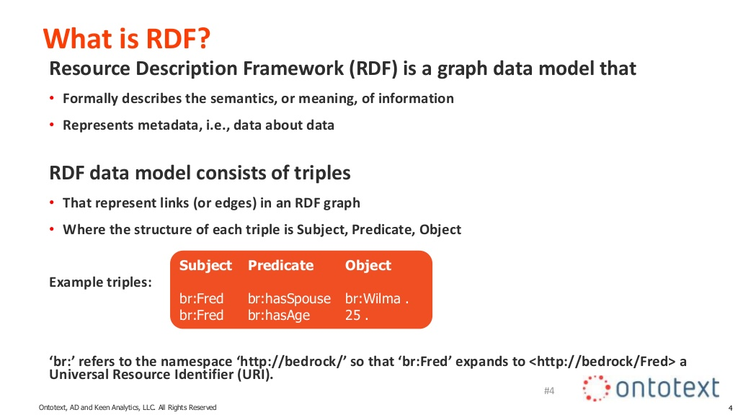
https://www.slideshare.net/ontotext/graphdb-fundamentals/4

Slide 8
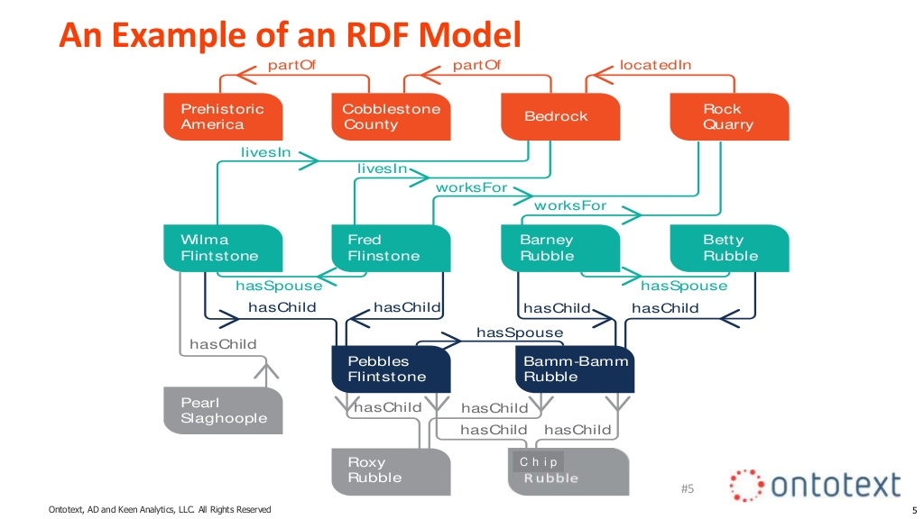
https://www.slideshare.net/ontotext/graphdb-fundamentals/4

Slide 9
RDF Overview
Very Simple Graph Format
Part of the Semantic Web Toolkit
Allows the Creation of Ontologies

Slide 10
What is an ontology?
An ontology is a shared and reusable formal specification of a conceptualization.
A conceptualization is a tuple (D, R), where
D – a set, the universe of discourse
R – a set of relations between on D

Slide 11


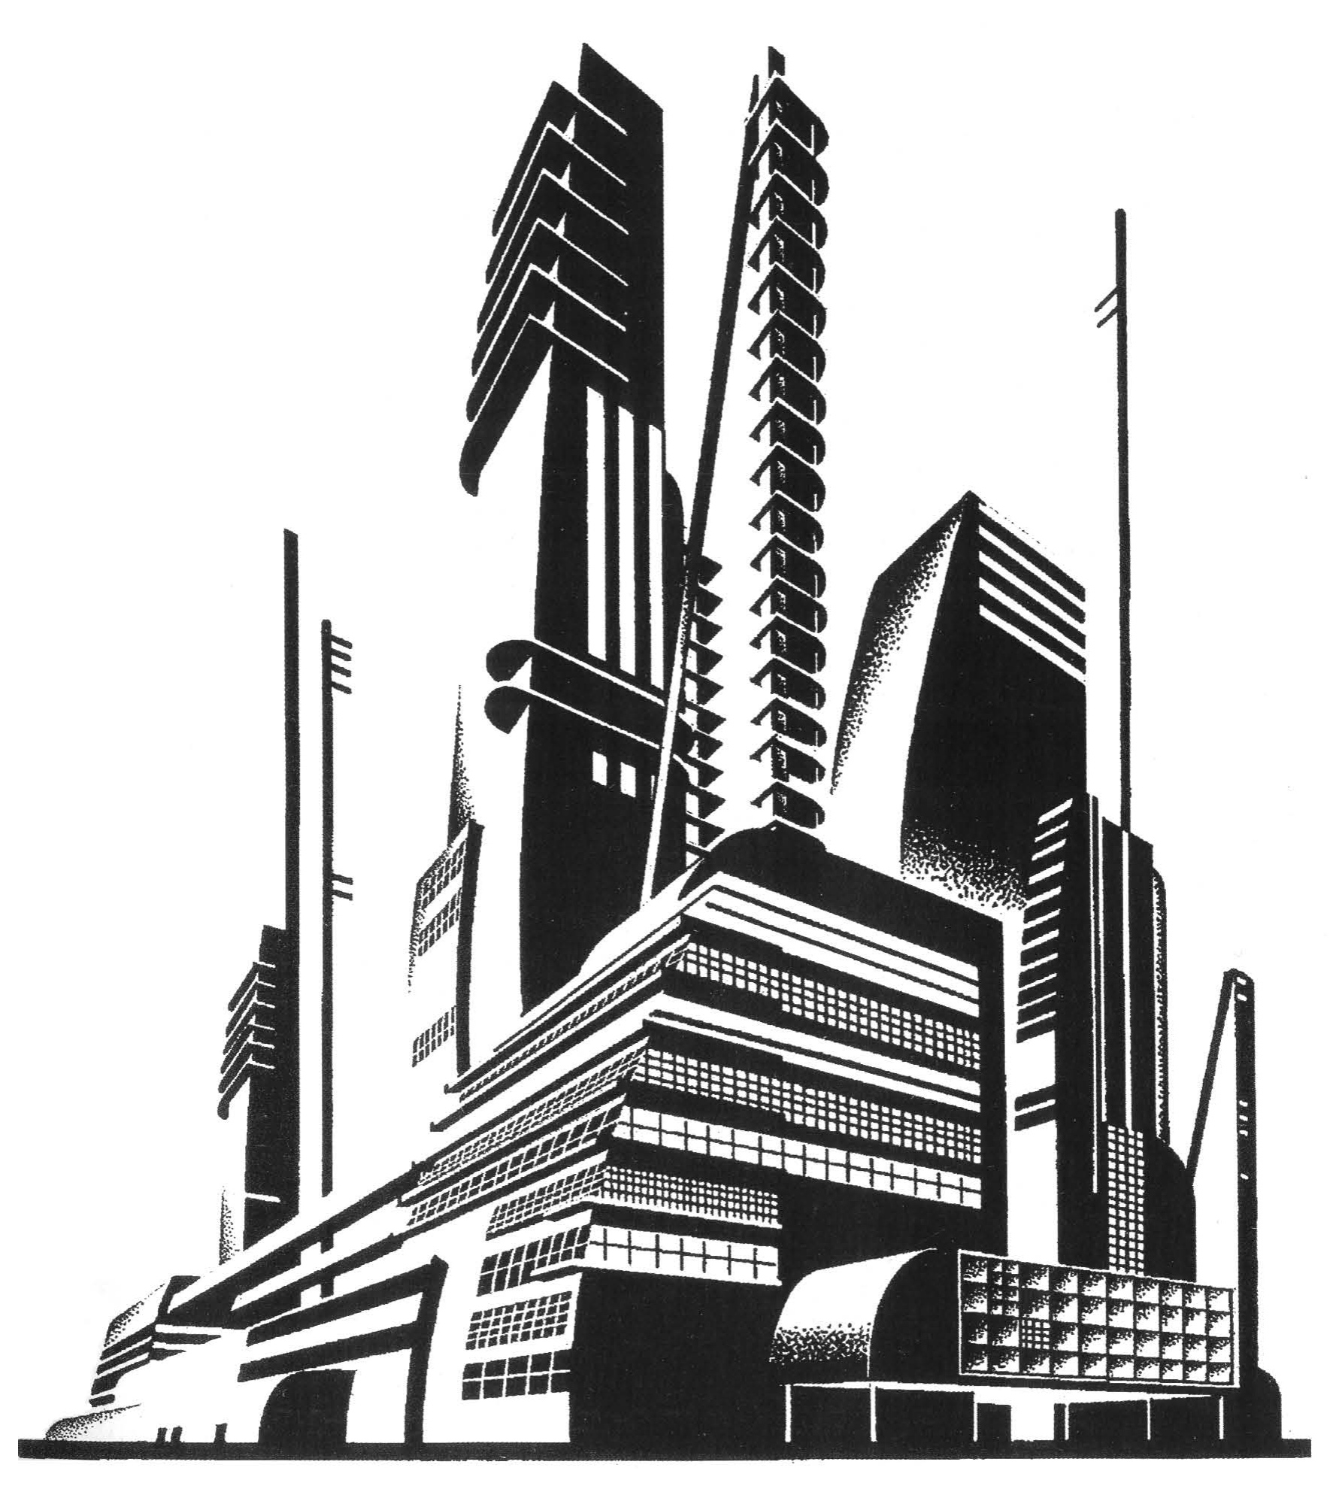
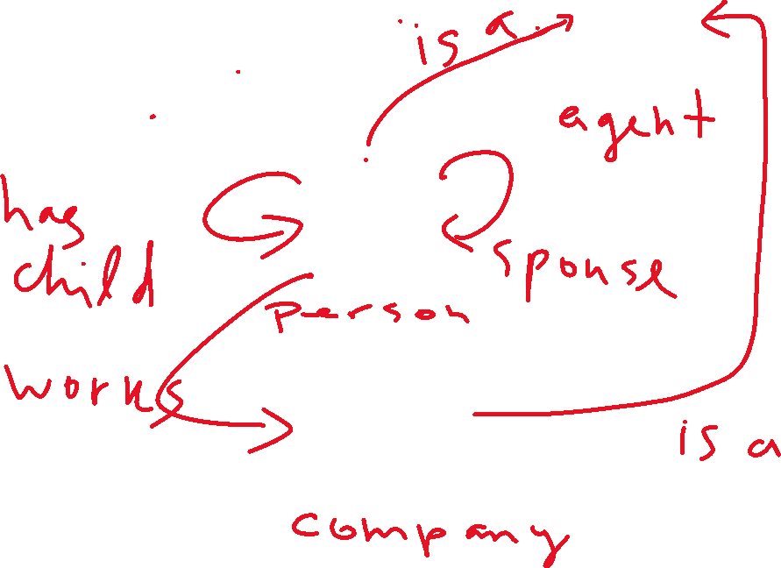

Slide 12
Expressing formally in OWL
:Person a owl:Class ;
rdfs:subClassOf :Agent .
:Company a owl:Class ;
rdfs:subClassOf :Agent .
has_child a rdfs:Property ;
rdfs:domain :Person ;
rdfs:range :Person .
works_for a rdfs:Property ;
rdfs:domain :Person ;
rdfs:range :Company .
Logical Implications
IF X has child THEN X is a Person
IF X works for Y THEN X is a Peron and Y is a Company
X and Y are both Agents

Slide 13
OpenBiodiv-O
An ontology of the taxonomic process used for knowledge extraction from taxonomic papers.

Slide 14
Domain Ontologies
Semantic Publishing and Referencing Ontologies (SPAR)
DarwinCore (DwC) and Darwin Semantic Web (Darwin-SW)
NOMEN, an ontology defining the rules of biological nomenclature
Open Biological and Biomedical Ontology (OBO) Foundy
Environment Ontology (ENVO)

Slide 15
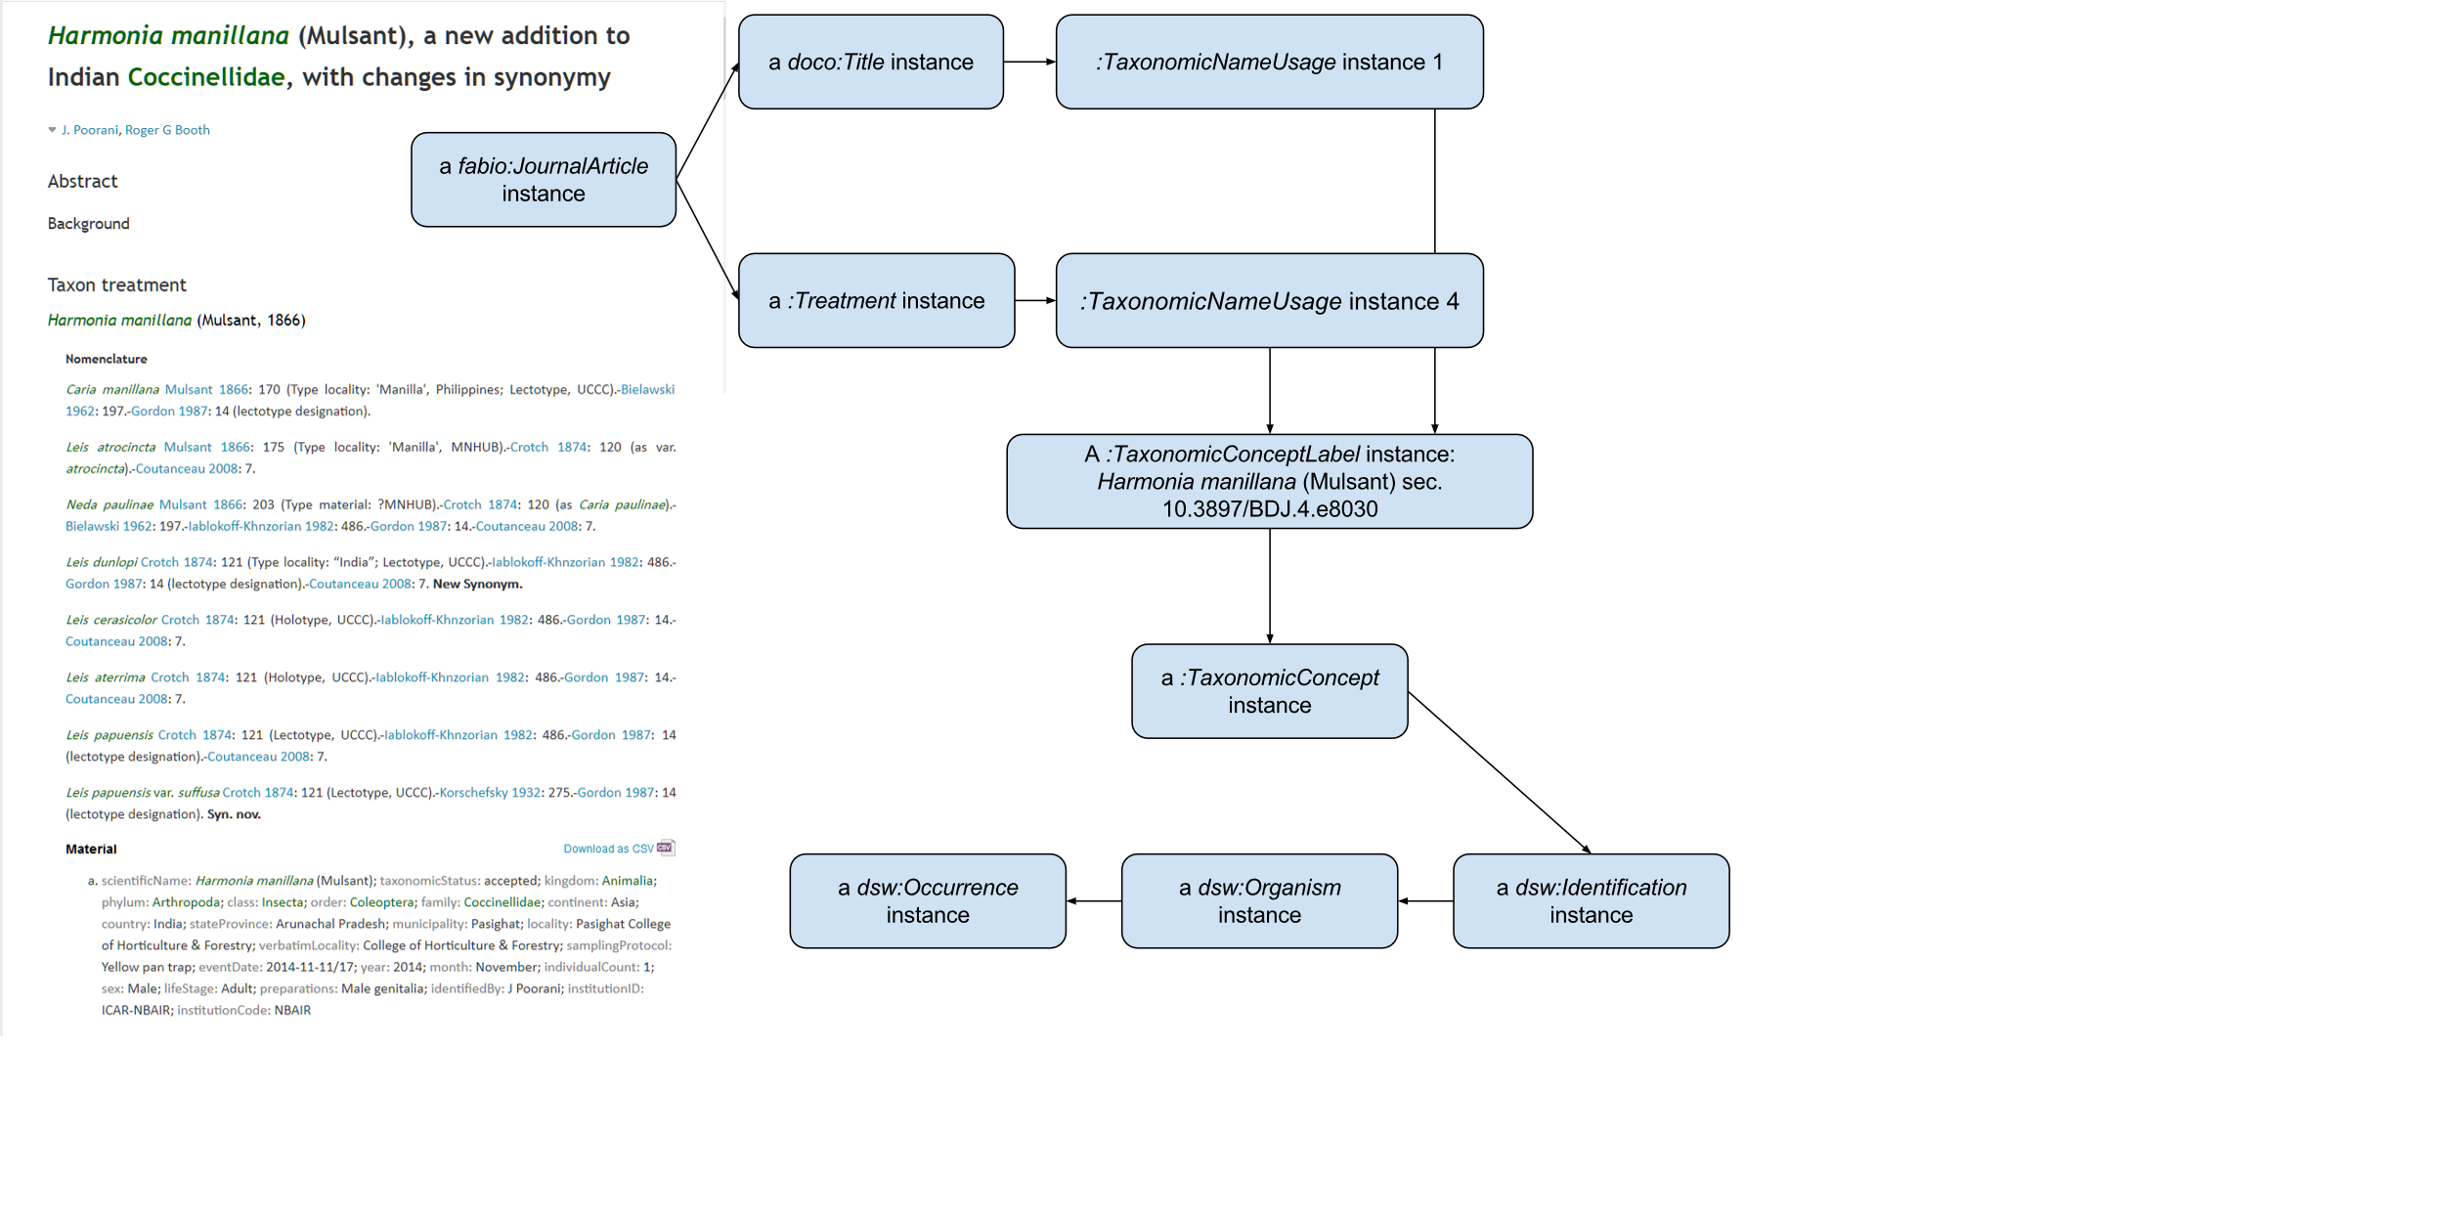
Notes:
But how is knowledge extracted from literature? For this we need a data model – in our case RDF – and an ontology (i.e. axioms on how to apply the data model). In this slide, I outline how prominent components of a biodiversity publication are turned into graphical representation utilizing our ontology. EXPLAIN THE GRAPH

Slide 16
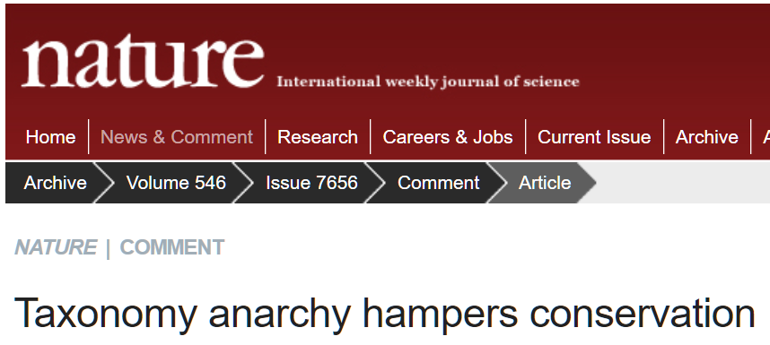
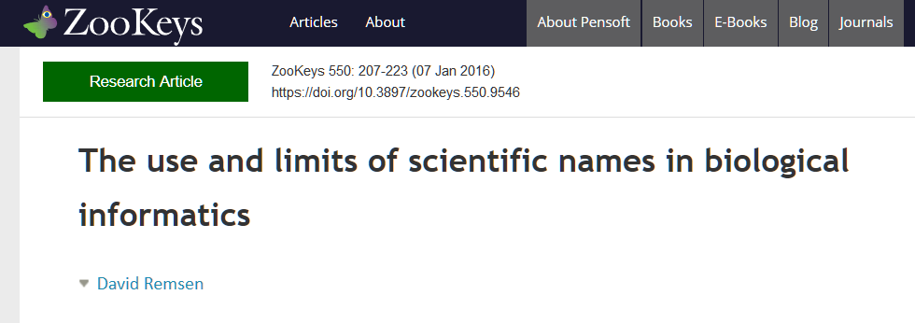
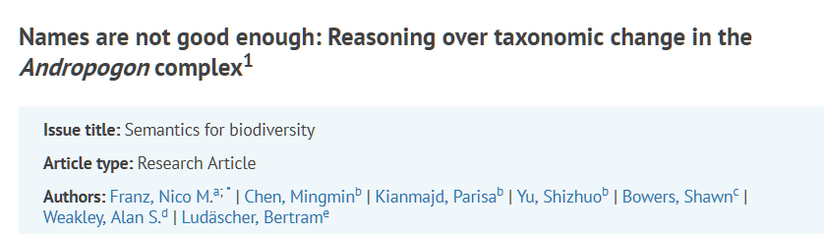
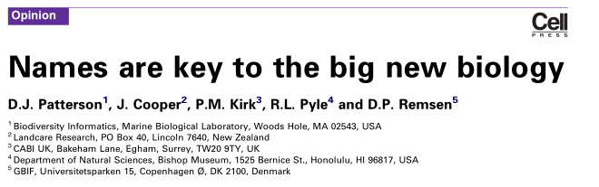

Slide 17
Problems with Using Binomial Names to Identify Taxa
Synonymy: many words for one meaning
Drosophila melanogaster = Sophophora melanagoster
Polysemy: one word for multiple meanings
Echidna Cuvier 1791 = ant eater; Echidna Forster 1777 = eel
Taxonomic revisions

Slide 18
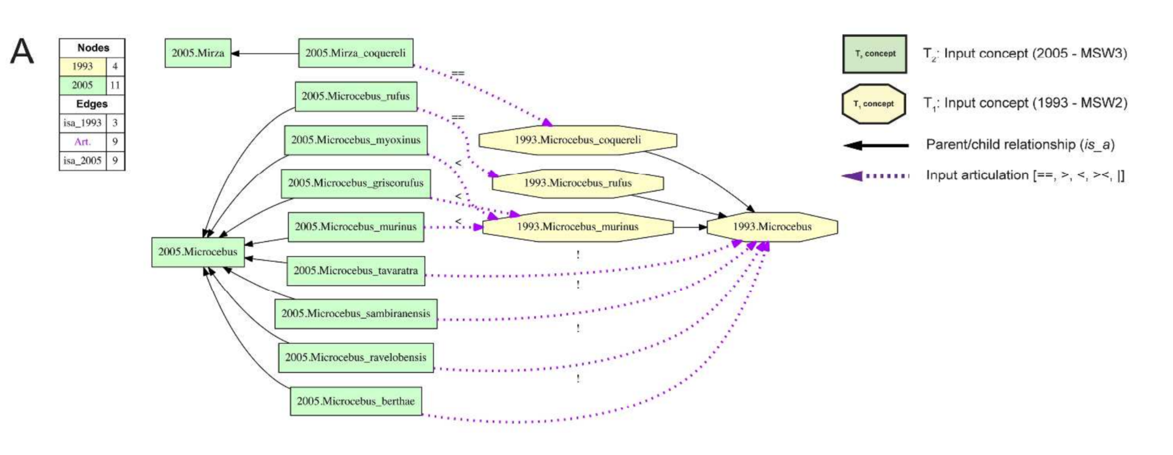
https://academic.oup.com/sysbio/article-abstract/65/4/561/1753624
Franz et al (2016)

Slide 19
Solution: Use Taxonomic Concept (Labels)
Microcebus sec. Groves (2005)
Microcebus sec. Groves (1993)
Groves C.P. 2005. Order Primates. In: Wilson D.E., Reeder D.M., editors. Mammal species of
the world, a taxonomic and geographic reference, third edition. Johns Hopkins University
Press, Baltimore, Maryland, pp. 111–184.
Groves C.P. 1993. Order Primates. In: Wilson D.E., Reeder D.M., editors. Mammal species of
the world, a taxonomic and geographic reference, second edition. Smithsonian Institution
Press, Washington, D.C., pp. 243–277.

Slide 20
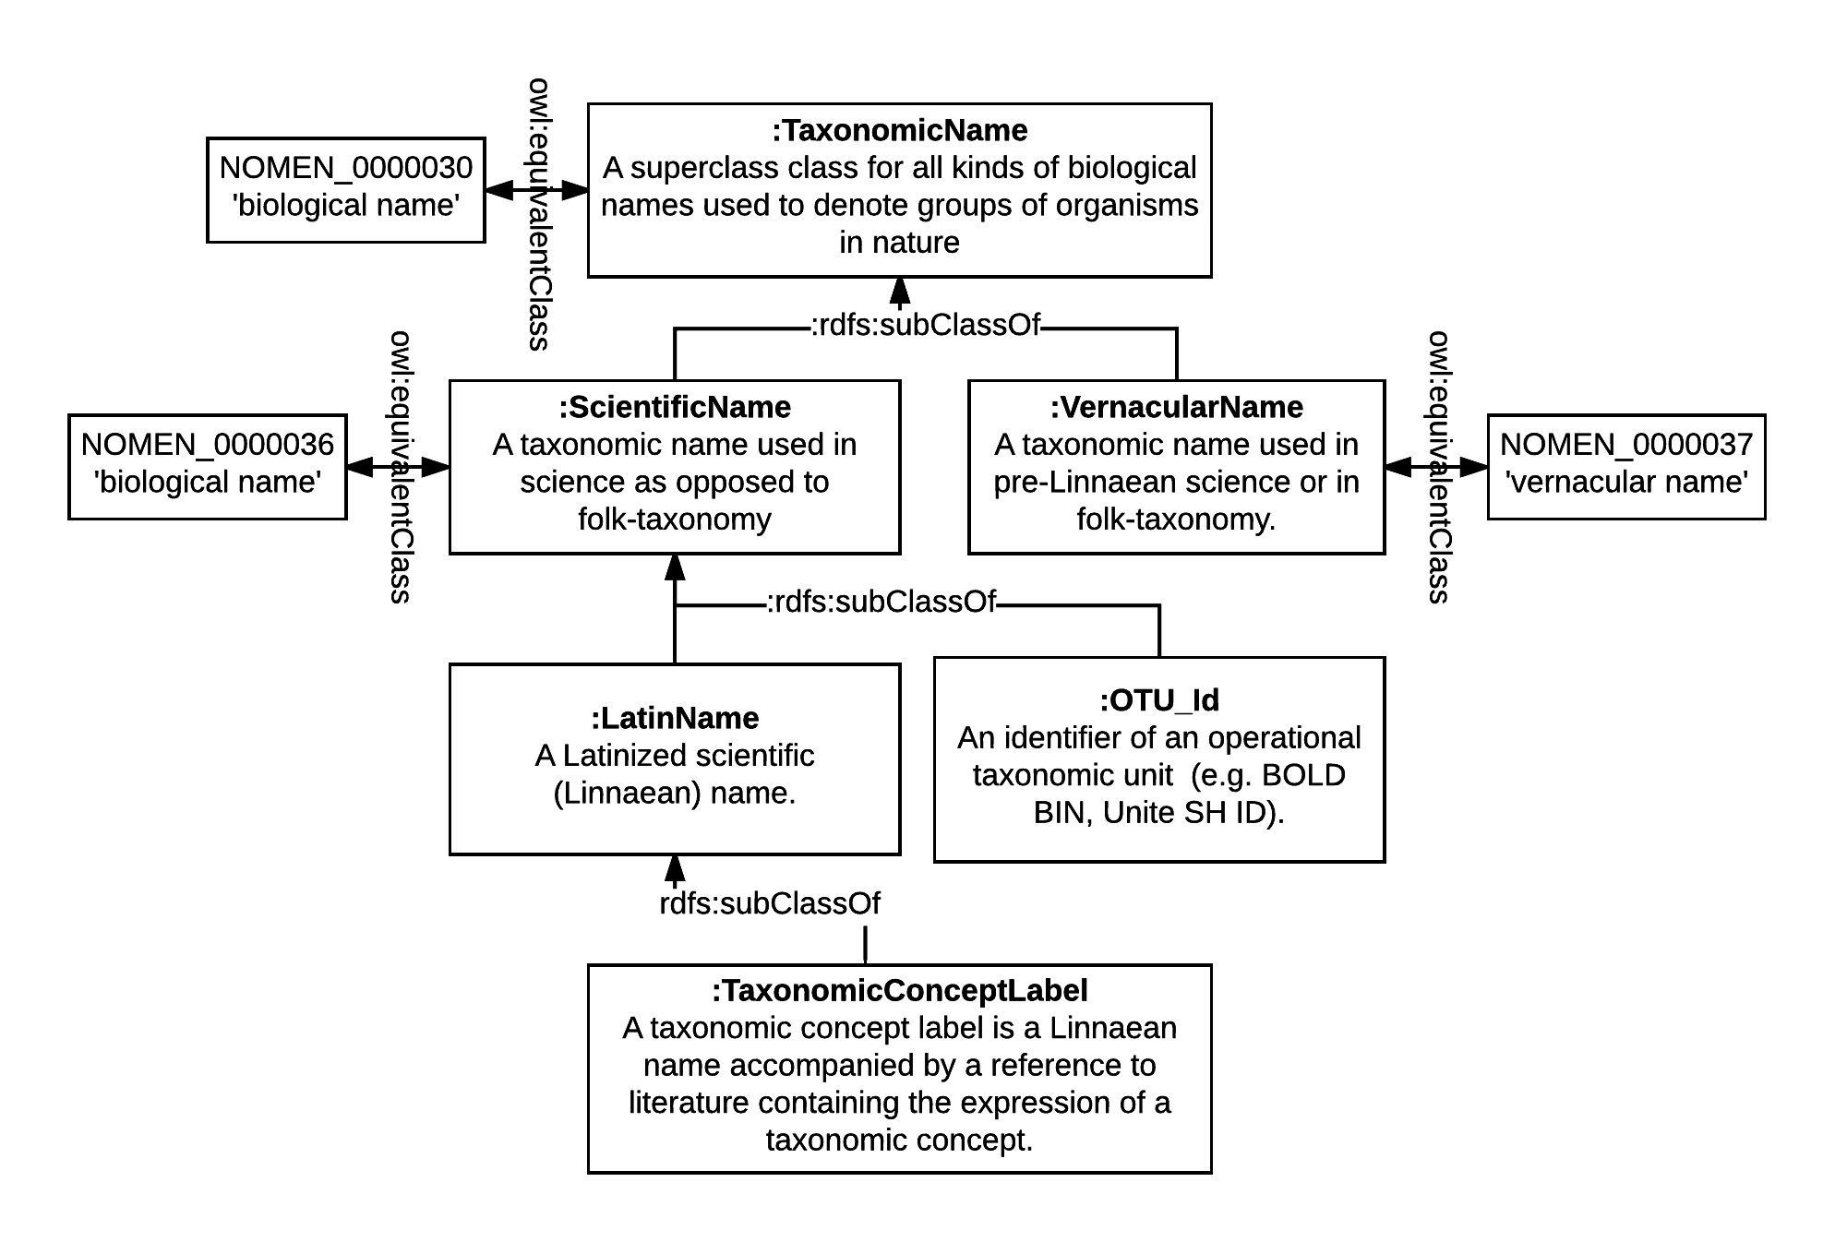

Slide 21
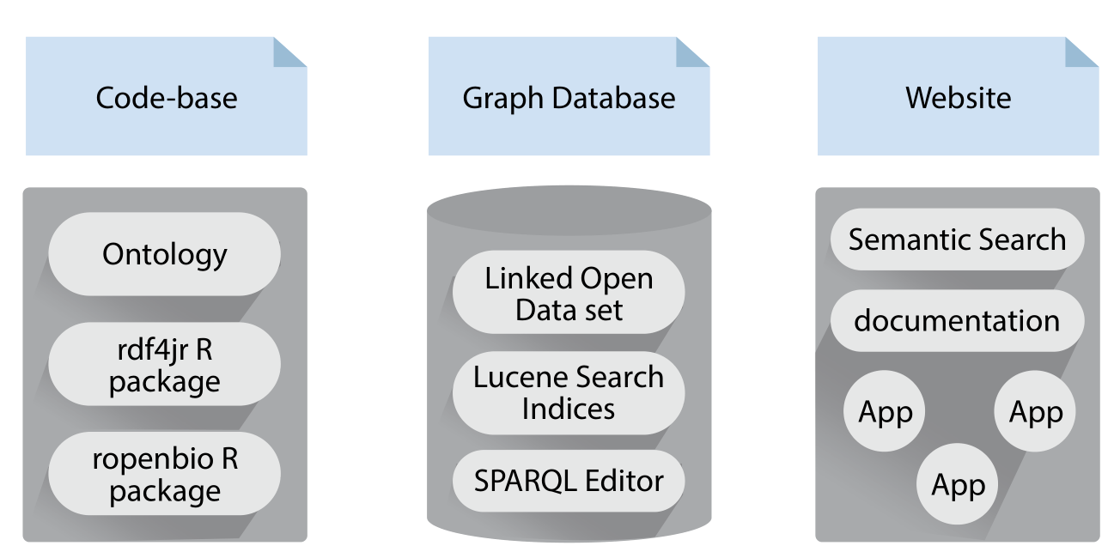
What is OpenBiodiv?
Notes:
OpenBiodiv is not one thing. In fact we use the name to refer to three distinct entities. Above everything else, OpenBiodiv is a semantic graph database. The database contains the LOD dataset but is a little bit more – it hosts a Lucene Search index, an API, a workbench with a SPARQL editor – all available to its users. To create the dataset/database we wrote own R libraries for RDF-ization and our own ontology – more about them later. While these two components were already present in a rudimentary form during last year’s TDWG, this year we also want to present to you the beta version of the website developed at Pensoft.

Slide 22
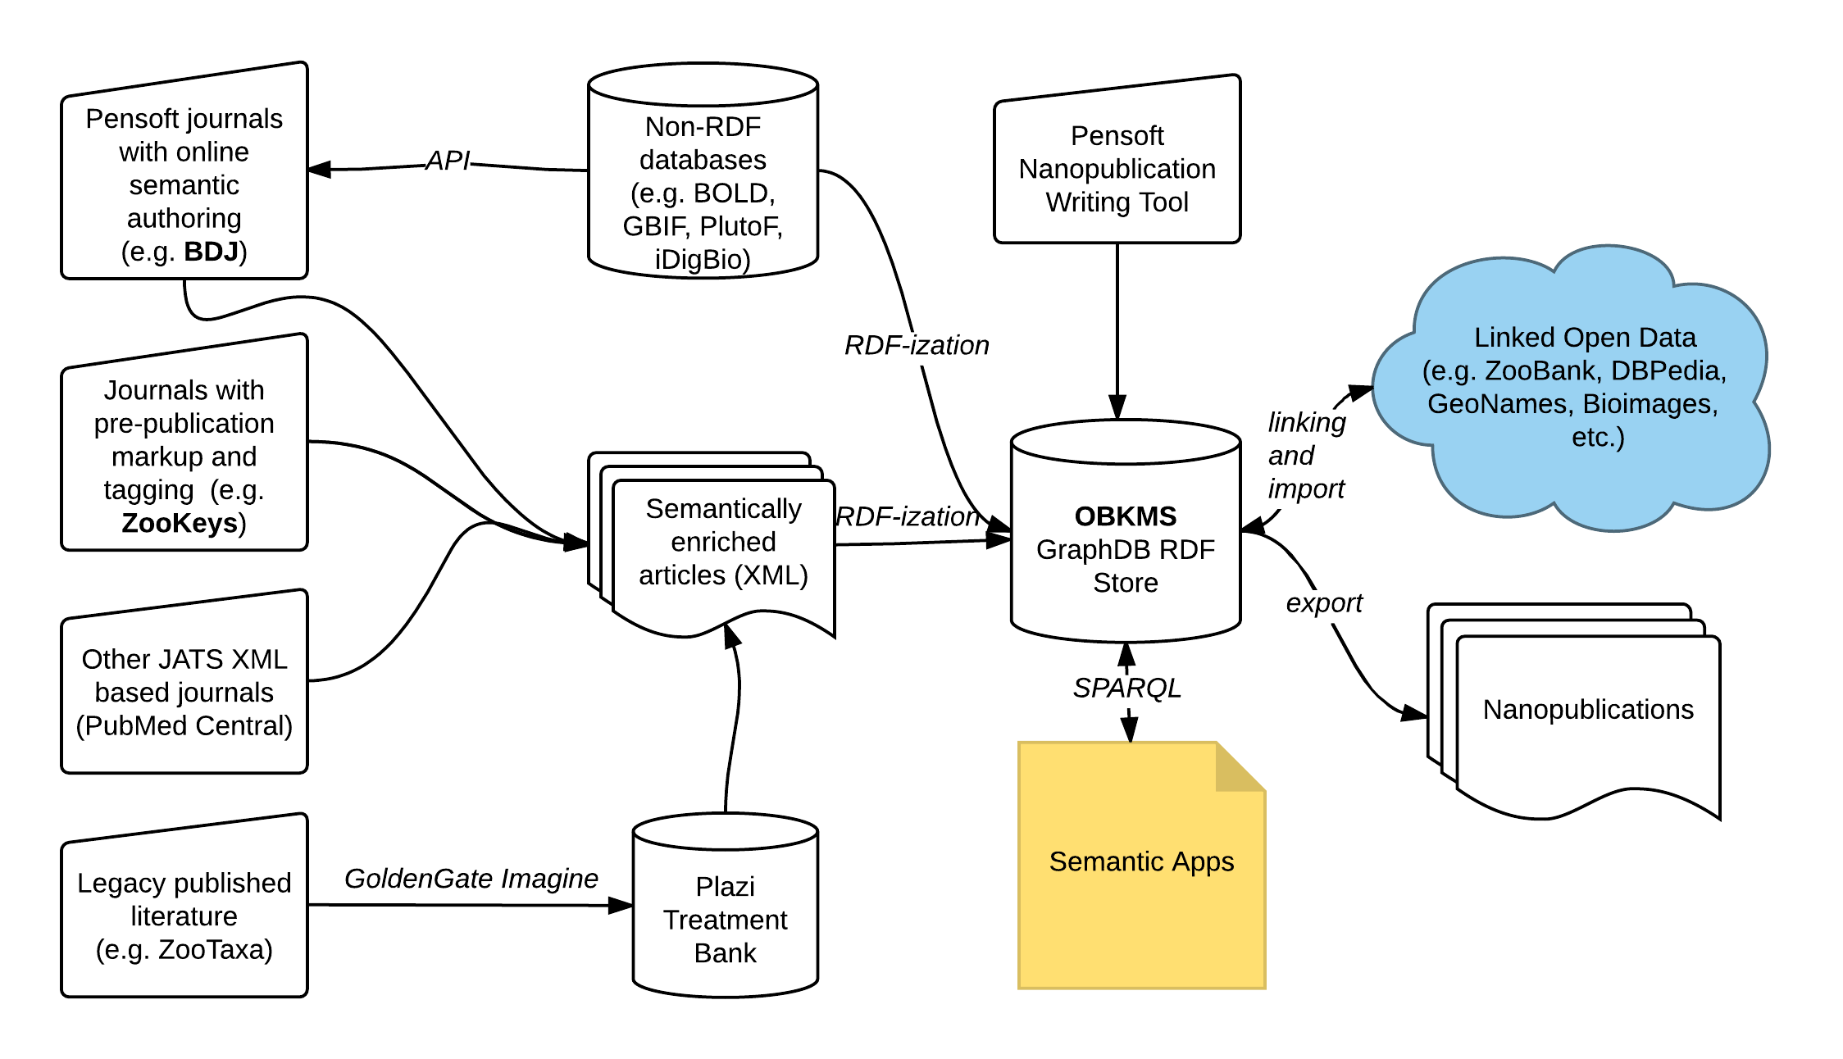
Where is data obtained from?
Notes:
This graph is something that I showed during last year’s presentation so some of you might be familiar with it. It roughly outlines where the data for OpenBiodiv comes from and where it goes. The core of the system is information extracted from Pensoft’s multiple taxonomic journals (TaxPub XML) and Plazi’s digitized legacy literature. After knowledge is extracted it is then linked to (for now) DBPedia and aggregators such as ZooBank, but will soon be linked to GeoNames, GBIF, and possibly BioImages.

Slide 23
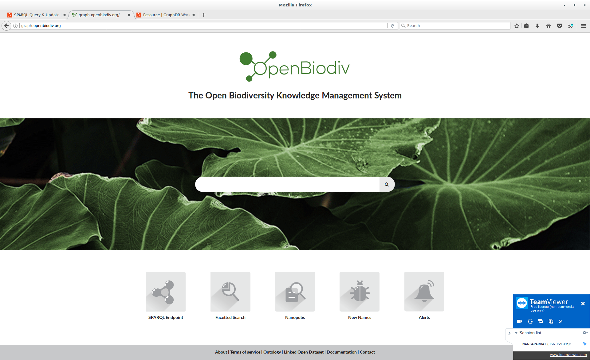

Notes:
Enough theoretical talk! The system is now on-line for all to test as a beta-release under openbiodiv.net!!
It’s main window features a semantic search interface as well access to various apps. The semantic search interface operates intuitively allowing you to browse the graph database based on the templates that we’ve created for key datatypes without the need to write SPARQL.

Slide 24
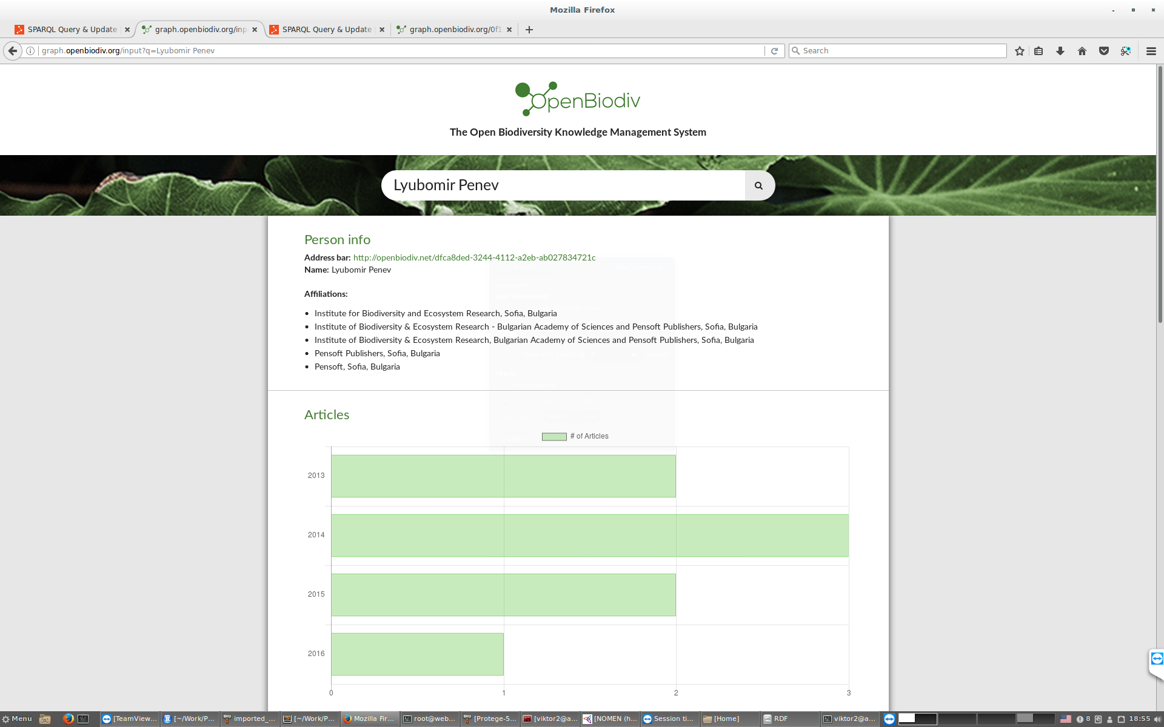
Notes:
For example, here I’ve typed the term Lyubomir Penev and the system has correctly identified it as a Person and invoked the Person template, giving me general information about the person as well as person statistics. From here I can also browse the top collaborators of this person and see their statistics.

Slide 25
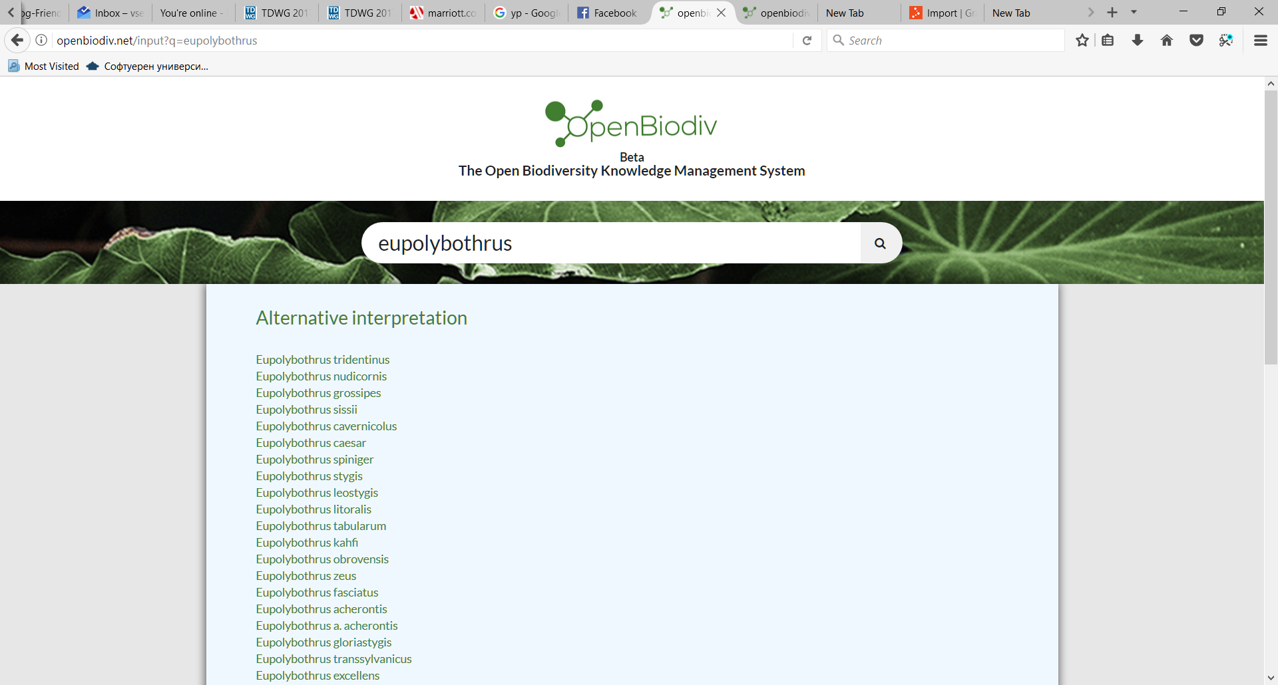

Slide 26
RDF-ization with ropenbio
Data gathering
Extraction
Serialization
Submission to the database
Notes:
I know want to shift the focus to the process of RDF-ization accomplished by our R packages. My definition of RDF-ization is perhaps somewhat narrower that others, as I only discuss here the lifting of information already in a semi-structured format (i.e. XML, or CSV) to RDF.
The process entails 4 steps: READ AND COMMENT THE STEPS

Slide 27
Extraction
XML Document (node) → RDF (Turtle)
Complexity reduction
Object construction:
Atom extraction
Lookup of identifiers (including external identifiers)
RDF-ization
RDF-ization of individual object
“Connect” all of the objects that the extractor has created via appropriate predicates
Notes:
I want to further discuss the process of Extraction (accomplished by Extractor functions in our framework).
XML is broken up into components (XML nodes) corresponding to parts of the paper (such as Title, Abstract, Figure, etc.)
Individual components are used to construct objects in memory corresponding to class instances in the data model
Atom extraction: individual atom locations (e.g. XPATH) are read to get the Literals and URI’s that will be the subjects in our triples
Disambiguation step: the database is queried to see if it contains an entity for the object. If yes, then its ID is returned. If no, then a new one generation
RDF-ization step: the objects are represented as RDF
There are functions that know how to convert indidual objects to RDF
On top of that, the extractors now how to link them together.
It is important to note here that one component may create several objects. E.g. a TaxonomicNameUsage component creates both a TaxonomicNameUsage object and a TaxonomicName object. A Treatment component creates both a Treatment and a TaxonomicConcept object. Finally, Everything is packaged and submitted to the server.

Slide 28
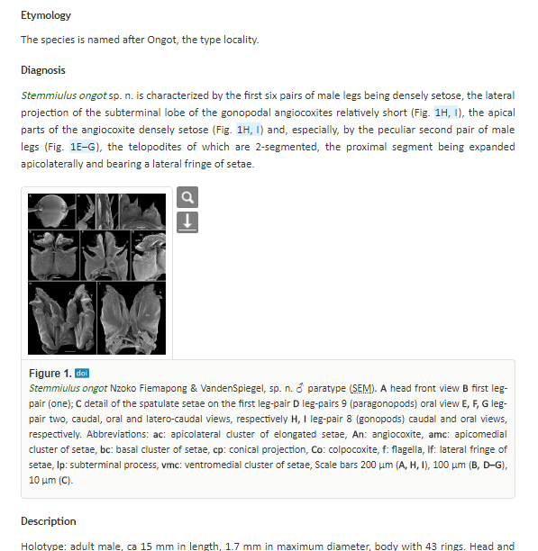
What About Machine Learning?
Create Vector Representations of Taxonomic Names
GLOVE
Word2Vec
Create Vector Representations of Images of Taxa
Inception-v3
ResNet
VGG16 - expected to work good but it is heavy
DenseNet - fast, worth trying
Create Topic Models of Treatments
Mallet

